Slide 1
GOA Pacific cod aging error and bias
Significant change in length-at-age was identified for pre- and post-2007 in GOA Pacific cod
Change in otolith reading methodology had occurred in 2007 correcting for an age-reading bias based on oxygen isotope analysis
In 2018 ages read in 2005 were re-read to check for error and bias, substantial over-aging was identified
Aging bias was fit within the 2019 model for 1976-2006 using a two parameter linear function for ages 3 through 10
Ageing error was fixed in the 2019 model as a two parameter linear function for all ages fit to the standard deviation of the otoliths read in 2007-2019 by multiple readers

Slide 2
Fitting ageing error for GOA Pacific cod in Stock Synthesis:
Control file
2 #_Nblock_Patterns
1 #_blocks_per_pattern
# begin and end years of blocks
1976 2006
#
----------------------------------------------------
# Age Error from parameters
-10 10 3 0 0 0 -5 0 0 0 0 0 0 0 # AgeKeyParm1 – Bias starts at age 3
-10 10 0 0 0 0 -10 0 0 0 0 0 1 2 # AgeKeyParm2 – No bias for 2007 2021
-10 10 0 0 0 0 -10 0 0 0 0 0 1 2 # AgeKeyParm3 – No bias for 2007 2021
-10 10 0 0 0 0 -1 0 0 0 0 0 0 0 # AgeKeyParm4 - Power parameter on bias not used
-10 10 0.57 0 0 0 -1 0 0 0 0 0 0 0 # AgeKeyParm5 – Standard deviation of age at age 3
-10 10 1.16 0 0 0 -1 0 0 0 0 0 0 0 # AgeKeyParm6 – Standard deviation of age at age 10
-10 10 0 0 0 0 -1 0 0 0 0 0 0 0 # AgeKeyParm7 -Power parameter on error not used
# catch multiplier
--------------------------------------------------------------------
#_ LO HI INIT PRIOR PR_SD PR_type PHASE
-9 9 0.378935 0 0 0 9 # AgeKeyParm2_BLK6repl_1976 – Bias fit for 1976-2006 at age 3
-9 9 -0.441655 0 0 0 9 # AgeKeyParm3_BLK6repl_1976 – Bias fit for 1976-2006 at age 10

Slide 3
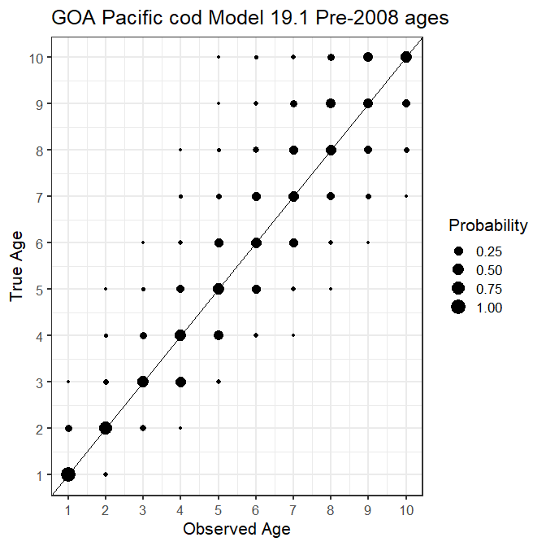

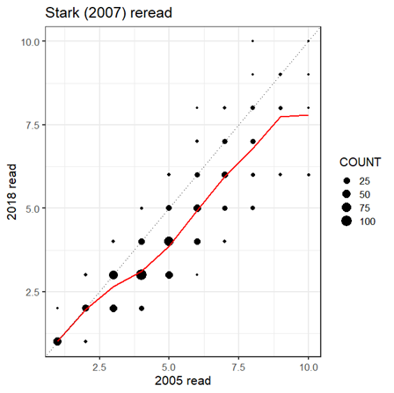
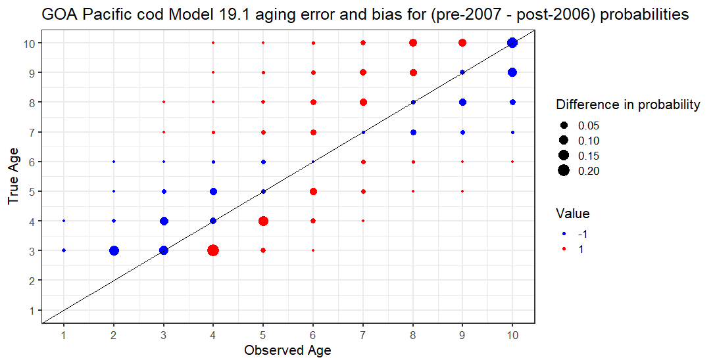
Aging error and bias fit in GOA Pacific cod Model 19.1
1977-2006 Error and Bias
2007-2021 Error and Bias
Age data re-read with new protocols

